Slide 1
Web application / Server side
1. Static Websites
Basic HTML/CSS websites with fixed content.
No databases or dynamic elements.
Examples: Personal portfolios, small business brochures.
2. Dynamic Websites
Content changes based on user interaction or databases.
Often use PHP, Python, JavaScript, or CMS platforms.
Examples: Blogs, news sites, forums.
A) Single page B)server rendering D)API
Web Application : Centralize Processing in sharable device (Server) and sharable Data Bases for each plat-forms building a web application that is suitable for a different size Devices and screens, but if you want to create a multi-platform application, that is, it works as a desktop application, as an application on smart phones, and as a web application, and you aspire to link the system with other systems, here you will be faced with one of two ways.

Slide 2
Why to use server application ?
Manage Resources
Decoupling and Abstraction
Security
A) Controlled Access (Validation, Authorization, Authentication)
B) Don’t provide direct access to Database
C) Reduce the impact of the cyber attack
Scalability and Extendibility
A)Connect multi services /DB at same time
B)Can be provide better load Management
C)Cach/Sessions
Flexibility
A)Multi Direction to get service
B)Data Transforming and form minting
6) Version Control
7) Logging (File): monitor and tracking for the system status

Slide 3
Framework Definition
Framework : s a reusable, structured set of tools, libraries, and conventions designed to streamline the development of software applications by providing a foundation to build upon. It enforces best practices, reduces repetitive code, and abstracts low-level complexities, allowing developers to focus on application-specific logic.
ASP.NET is a server-side web application framework developed by Microsoft, designed for building dynamic websites, web applications, and APIs. It is part of the .NET platform and allows developers to create robust, scalable, and high-performance web solutions using languages like C#, VB.NET, and F#.

Slide 4
APIs Fundamental
PI: Definition & Abbreviation
Abbreviation:
API stands for Application Programming Interface.
Definition:
An API is a set of rules, protocols, and tools that allows different software applications to
communicate with each other. It defines how software components should interact,
enabling:
Data exchange between systems.
Function calls between programs.
Integration of third-party services.

Slide 5
API Types
APIs can be categorized based on their architecture, accessibility, and use cases. Here are the main types:
1. By Architecture (Protocol/Design)
a) REST (Representational State Transfer) API
Uses HTTP/HTTPS (GET, POST, PUT, DELETE).
Stateless, cacheable, and returns data in JSON/XML.
Example: Twitter API, GitHub API.
b) SOAP (Simple Object Access Protocol) API
XML-based, strict standards (WSDL).
Used in enterprise systems (banking, healthcare).
Example: PayPal SOAP API.
c) GraphQL API
Allows clients to request only needed data (no over-fetching).
Single endpoint, flexible queries.
Example: GitHub GraphQL API.
d) gRPC (Google Remote Procedure Call)
High-performance, uses Protocol Buffers (binary format).
Popular in microservices & real-time apps.
Example: Cloud services (Google, Netflix).
e) WebSocket API
Real-time, bidirectional communication (chat, live updates).
Example: Stock market APIs, gaming APIs.

Slide 6
Definition & features of RESTful APIs
A RESTful API (Representational State Transfer API) is an architectural style for designing networked applications.
It relies on stateless, client-server communication using standard HTTP methods (GET, POST, PUT, DELETE).
RESTful APIs are widely used in web services due to their simplicity, scalability, and compatibility with the web.
1. Stateless
Each request contains all necessary information (no server-side session storage).
Improves scalability (servers don’t need to retain client state).
2. Uniform Interface
Resource-based URLs (e.g., /users/123).
Standard HTTP methods (GET, POST, PUT, DELETE).
Self-descriptive messages (JSON/XML with metadata if needed).
3. Client-Server Separation
Client (UI) and server (data/logic) evolve independently.
Enables multi-platform support (web, mobile, IoT).
4. Cacheable
Responses can be explicitly marked as cacheable (reduces server load).
Uses HTTP headers like Cache-Control.
5. Layered System
Intermediary layers (load balancers, proxies, gateways) can be added without client awareness.
Enhances security, scalability, and performance.
6. Code on Demand (Optional)
Servers can send executable code (e.g., JavaScript) to extend client functionality.

Slide 7
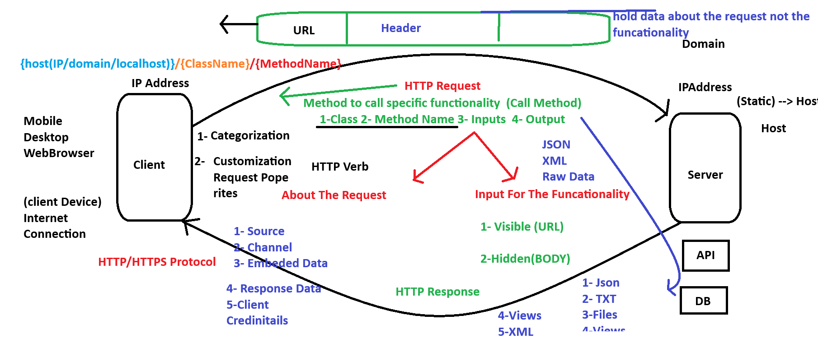

Slide 8
1- GET
For Fetch Information From API
- No Request Body - Passing Data Will be Only From URL (Query/Route)
Cached and save on browser history
2- Post
For Create New Element on The System
For Complex and Sensitive Data Search
Data Send From Body (Http Request There is only one Body) HTTP VERBS
Not Save on Browser History
3- Patch (Partial Update)
-Update Existing Elements
-you should sent only the changed data
-effect : more efficient and flexibility on request handling
Not Save on Browser History
4- Put (Full Update)
-Update Existing Elements
-Create New Element (Relationship / Weak Entity)
-Overwrite for all entity properties
-you should sent the whole object (changed/unchanged)
-Not Save on Browser History
5- Delete
Remove Record / Instance From Server
Body Exists (not recommend to use)
Not Save on Browser History
204 Preferred Status Code
6- Head
Simulation For Get Request with out receiving data
ensure that endpoint / api are exisit
7- Options
Simulation For Get Request with out receiving data
- Check for connectivity attribute
8- Connect
Fetch Connection on Server
9- Trace
- Trace The Request on Server

Slide 9
API Execution Flow
Client Request
The client sends an HTTP request to the API endpoint
Request includes:
HTTP Verb
Endpoint
Headers
Body (for POST/PUT/Patch requests)
Network Routing
Request travels through network
Reaches the API server
3. Server-Side Processing
Request Parsing
Web server receives the request
Passes it to the application server
Routing
Framework routes the request to the appropriate controller based on URL and HTTP method
Business Logic
Controller processes the request
Validates input data
Interacts with services/models
Performs database operations (CRUD)
Applies business rules

Slide 10
API Execution Flow
e. Data Processing
Retrieves or updates data from the external recourse (database)
Formats data according to API specifications
4. Response
Controller builds response:
Status code (200 OK, 404 Not Found)
Response headers
Response body (JSON/XML)
4. Response Delivery
Response travels back through network
Received by the client
5. Client Processing
Client processes the response:
Parses the data , Updates application state , Handles errors if present

Slide 11
APIs Properties
Common characteristics or features of an API, such as:
Endpoint :
The URL where the API can be accessed
HTTP Verb :
Like GET , POST , PUT , DELETE
Headers :
MetaData
Parameters:
Query or body parameters required by the API
Request/Response Body :
Data sent and received

Slide 12
Input Types Format : 1)Data about the request 2) for the functionality or method
Header Request :hold fata for the request not for functionality (source , channel ,Embedded ,Response Data)
Body Request : data for functionality or input for endpoint
Type of data : JSON , XML , Row Data , Text , File
Request Data : Visible (URL) , Hidden (Body)
URL : Ip or Domain / Endpoint / method / data input
Header : Source of Request / Authentication / Type of input / type of output /how of output /
/ channel(mobile , web , Desktop) /type of output
Body : Hidden data for inputs
HTTPS(s) : SSL Security certificate (the data is encrypted in request and response)
JSON : Java script object notation : can handle all type of data from multi programming language

Slide 13
URL Request Input Data Source
From Rout :
Protocol / Domain / class Name / method / parameter
Https / www.LinkedIn/ Users / Get / Mohammed Aloshaibi
Parameter fixed by (/)
No need to mention parameter name
2) From Query :
Https / YouTube / watch? V=122 & name = anything
Let the passing parameter is optional
The order in parameter is not necessary
Visible (URL) data input : Row Information , collection , object
Hidden (Body/Header) : File, JSON , Row Data , Collection
URL Response : Row , View , File , JSON , Collection

Slide 14
Http Response/Status Code :
HTTP response status codes indicate whether a specific
HTTP request has been successfully completed. Responses are grouped in five classes
Informational responses (100 – 199)
Successful responses (200 – 299)
Redirection messages (300 – 399)
Client error responses (400 – 499)
Server error responses (500 – 599)

Slide 15
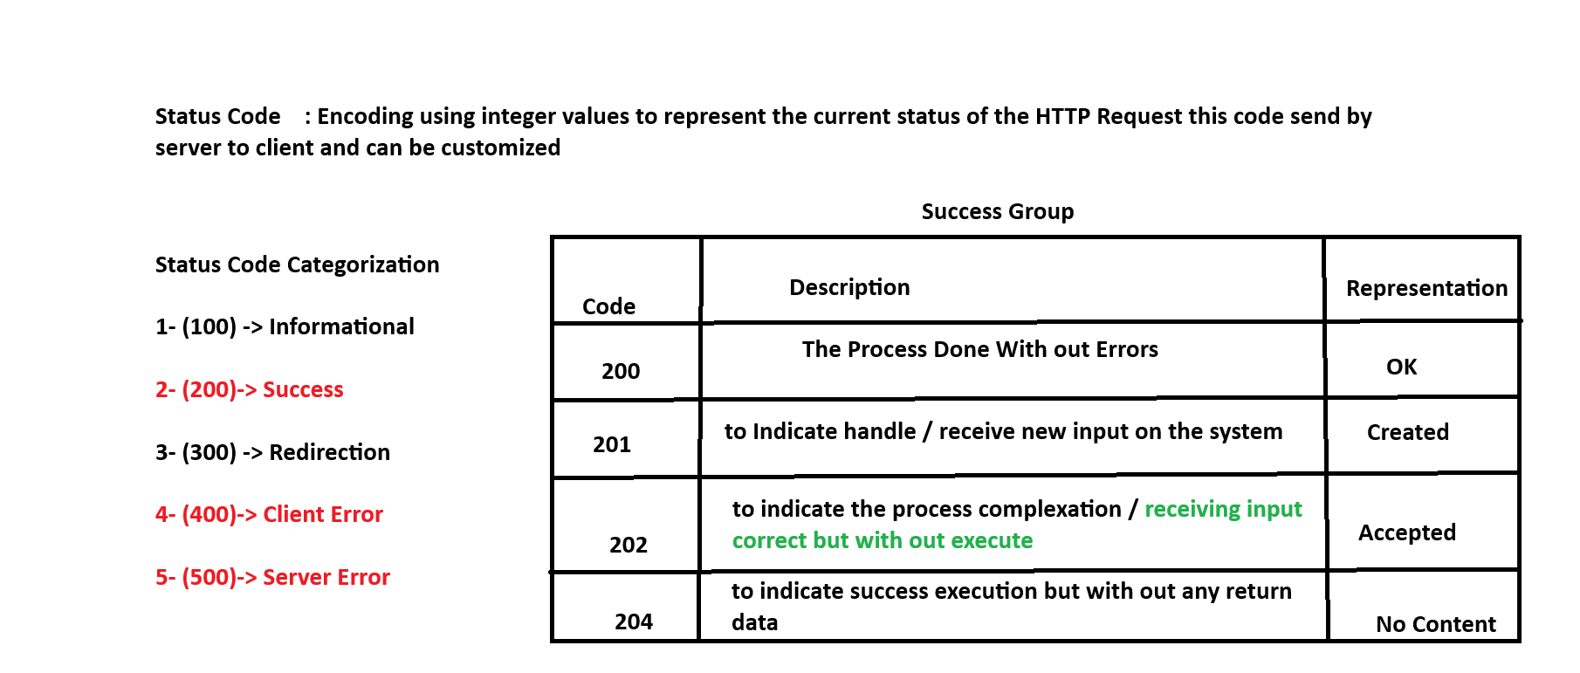
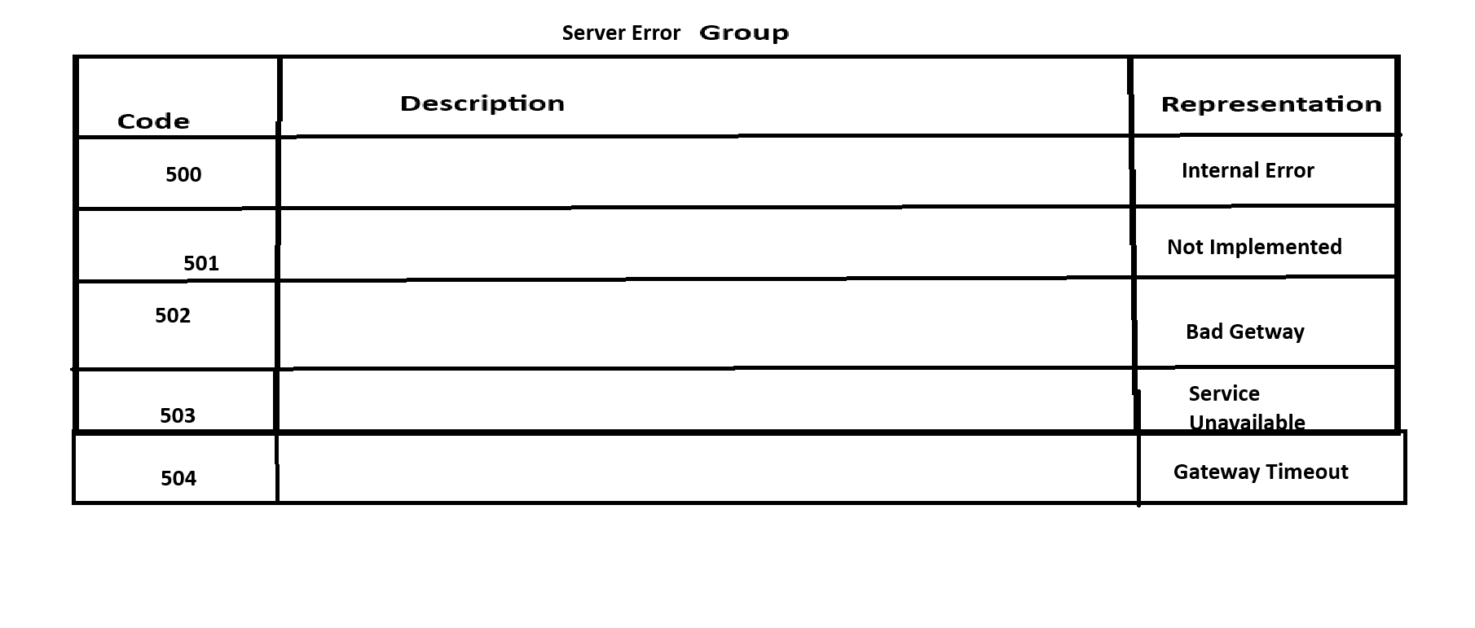
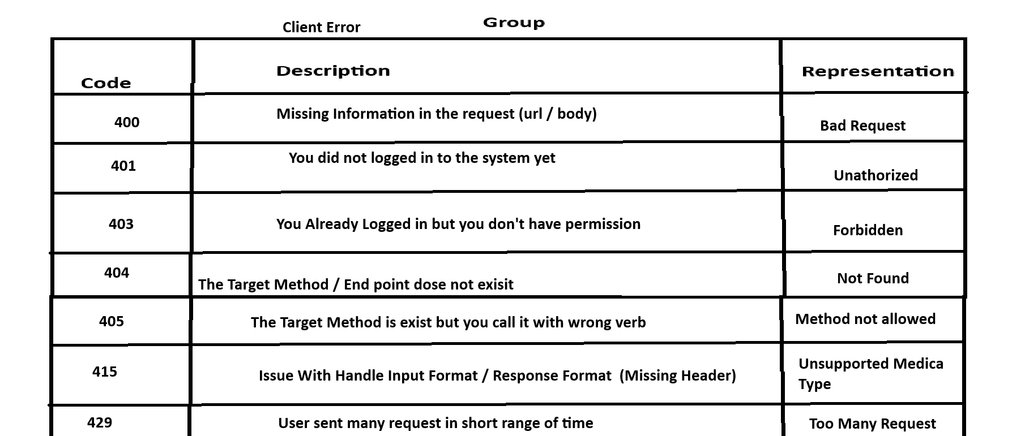

Slide 16
API Routing
is the process that matches an incoming HTTP request (URL + HTTP method)
to a specific controller and action method. This allows the server to process
the request and return the appropriate response
How Does Routing Work ?
The client sends an HTTP request with a URL and HTTP Verb
The backend check a predefined set of routes in the application
The routing finds a match to a controller and action based on the URL
The matched controller method processes the request and returns a response

Slide 17
Implementation Endpoint Steps
Set Up ASP.NET Core Project
Delete The Example Controller (WitherForCast)
Define Entities / DTOs (if any)
Define Controller
Define HTTP Verb
Define Route
Define Endpoint (Should be awaitable and with type IActionResult)
Start Implementation

Slide 18
API Structure
Controllers : is a C# class that can hold method and could be called via network
Entities : C# Class that have properties
DTOs : C# Class created to handle API input and API output
AppSettings.JSON : is a configuration file used in ASP.NET Core applications to store app settings,
such as database connection strings, API keys, logging levels, and custom settings
— all in a simple JSON format.
Helper : Static C# Class Created to be shared class between files in the solution
Swagger : toolset that automatically generates interactive documentation for APIs
Program.cs : startup file that builds and configures the web application.
It sets up services, middleware, configuration, logging, and runs the app

Slide 19
Endpoint Implementation
[Rout(“api[Controller]”)] // make me goals this Endpoint
[ApiController] // take the http request
[HttpPost] // to choose the verb of Request and Response
[Route("[action]")] // make me goals this Method
public async Task<IActionResult> Method_Name() // properties of this method
{
// Try & catch to 1)logging: operation tracing 2)Debugging: Friendly Errors 3)Handling
try
{
return Ok();
}
catch (Exception ex)
{
return StatusCode(500, $"An Error has been Detected : {ex.Message}");
}
}

